Slide 1






Detecting Spam Emails
Student Details
Name : DEEPIKA . D NM Id : au61772111013
College Name : GOVERNMENT COLLEGE OF ENGINEERING, SALEM - 11

Slide 2


Spam mail detection
Course Outline
Abstract
Problem Statement
Aims, Objective & Proposed System/Solution
System Deployment Approach
Model Development & Algorithm
Future Scope
Video of the Project
Conclusion
Reference

Slide 3

Spam mail detection
ABSTRACT
Email spam continues to be a pervasive issue, causing inconvenience and potential harm to users. In this project, we propose a machine learning approach to automatically detect spam emails. The project involves collecting a dataset of labeled emails, where each email is classified as spam or non-spam (ham). The project aims to develop a robust and efficient spam detection system that can be deployed to protect users from unwanted and potentially harmful emails.

Slide 4

Spam mail detection
PROBLEM STATEMENT
Detecting Spam Emails Using TensorFlow. Implement and build a deep-learning model for Spam Detection. The model we will try to implement will be a Classifier, which would give binary outputs- either spam or ham.

Slide 5

Spam mail detection
AIM AND OBJECTIVE
This project aims to develop an effective spam email detection system using machine learning techniques. The project will involve collecting a dataset of labeled emails, preprocessing the email text data, extracting relevant features, and training a machine learning model to classify emails as spam or non-spam (ham).

Slide 6

Spam mail detection
PROPOSED SOLUTION
Solution: Gather a dataset of labeled emails, where each email is labeled as spam or non-spam (ham). Preprocess the text data to convert it into a format suitable for machine learning models. This may include removing stop words, tokenization, and converting text to numerical representations. Extract features from the preprocessed text data. Common features include word frequency, TF-IDF (Term Frequency-Inverse Document Frequency), and N-grams. Choose a machine-learning model for spam detection. Common models include logistic regression, support vector machines (SVM), and naive Bayes classifiers.
This Photo by Unknown Author is licensed under CC BY-NC

Slide 7
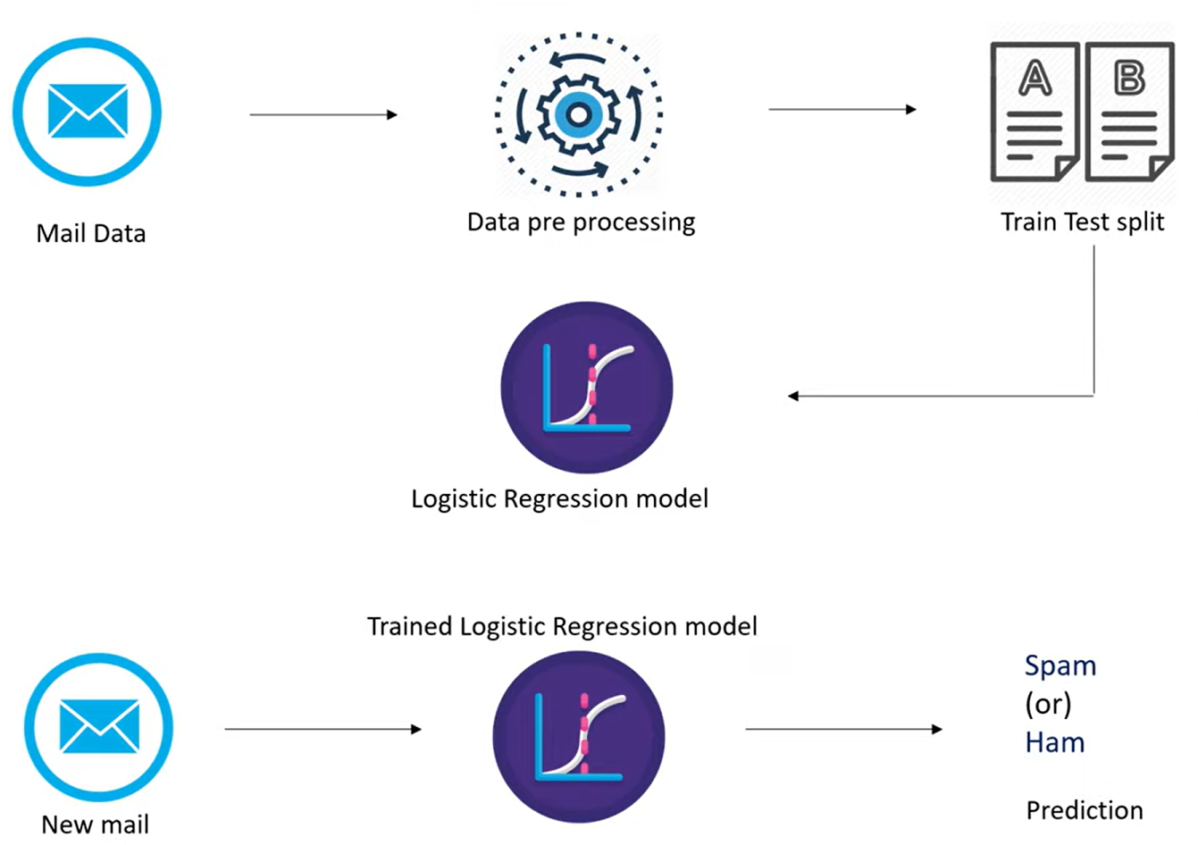
Spam mail detection
SYSTEM DEPLOYMENT APPROACH

Slide 8
Spam mail detection
MODEL DEVELOPMENT & ALGORITHM
Dataset Description:
The dataset contains set of Emails.
Size of dataset is 5572 rows
Categorized into two classes
Spam, Ham
Each class has around 2780 sentences

Slide 9
Spam mail detection
MODEL DEVELOPMENT & ALGORITHM
Algorithm:
Input: Email text data
Output: Spam or non-spam (ham) classification
Algorithm Steps:
Preprocess the email text data (e.g., remove stop words, tokenize).
Extract features from the pre-processed text data (e.g., TF-IDF, N-grams).
Train a machine learning model on the extracted features (e.g., logistic regression, SVM, naive Bayes).
Evaluate the trained model on a test dataset using metrics such as accuracy, precision, recall, and F1 score.
Fine-tune the model by experimenting with different preprocessing techniques, feature extraction methods, and model parameters to improve performance.
Deploy the trained model as a spam detection system for real-world use.

Slide 10
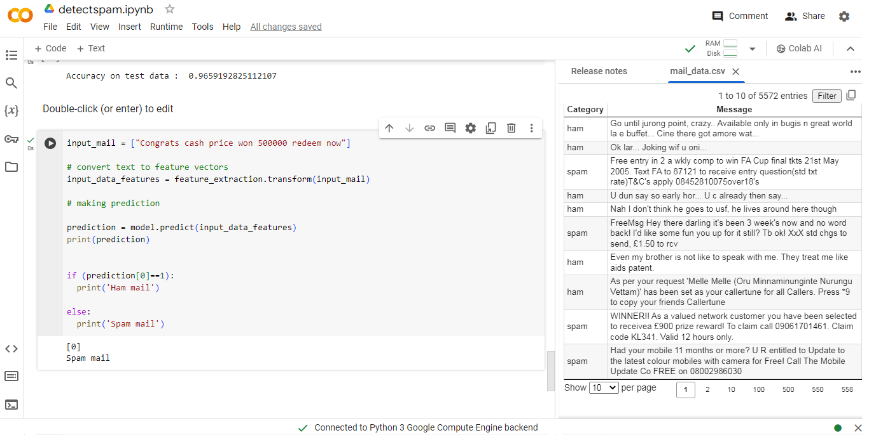
Spam mail detection
RESULT

Slide 11

Spam mail detection
FUTURE SCOPE
Advanced Machine Learning Techniques: Explore advanced machine learning techniques such as deep learning, ensemble methods, and natural language processing (NLP) to improve the accuracy and efficiency of spam email detection.
Real-Time Detection: Develop real-time spam detection systems that can quickly identify and filter out spam emails as they are received, providing users with immediate protection.
User Feedback Integration: Incorporate user feedback into the spam detection system to continuously improve its performance and adapt to new spamming techniques.
Multimodal Detection: Combine text-based features with other modalities such as images and metadata to improve the detection of sophisticated spam emails.

Slide 12
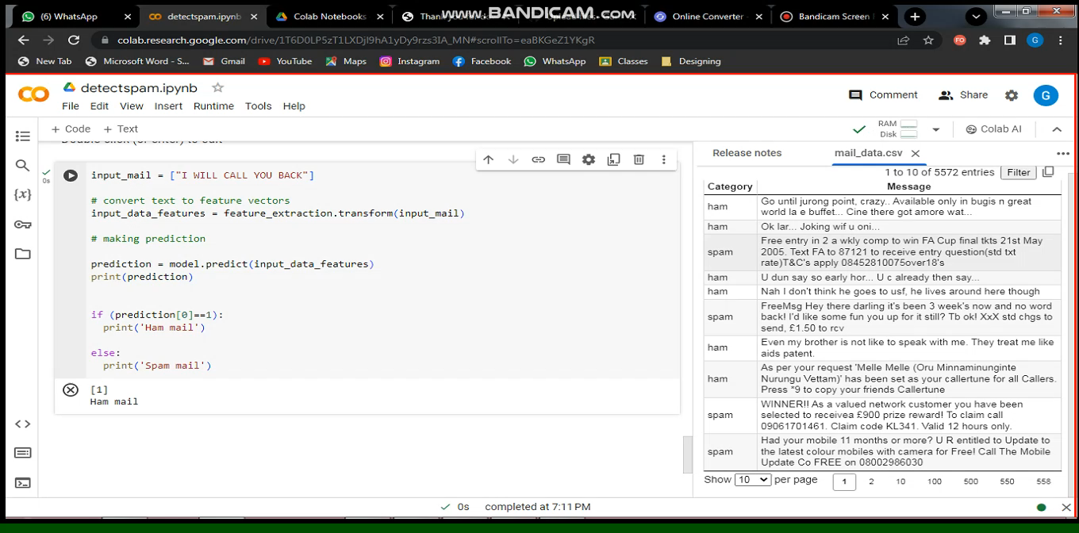
Spam mail detection
VIDEO OF THE PROJECT

Slide 13

Spam mail detection
CONCLUSION
In conclusion, our project on spam email detection using machine learning techniques has shown promising results in automatically identifying and filtering out unwanted emails. By leveraging machine learning models such as logistic regression, support vector machines (SVM), and naive Bayes classifiers, we could effectively classify emails as spam or non-spam (ham).
Moving forward, there is potential to enhance this system by exploring advanced machine learning techniques, implementing real-time detection, and incorporating user feedback. These improvements could further enhance the accuracy and efficiency of spam email detection systems, ultimately improving user experience and security.

Slide 14
Spam mail detection
Reference
https://www.coursera.org/
https://www.taskade.com
https://www.geeksforgeeks.org/

Slide 15

Thank You

